Slide 1
Student Guide
Arvinte Razvan George

Slide 2
Content
Summary+Motivation
Application Flow
Used technologies and alternatives
Contributions
Conclusion

Slide 3
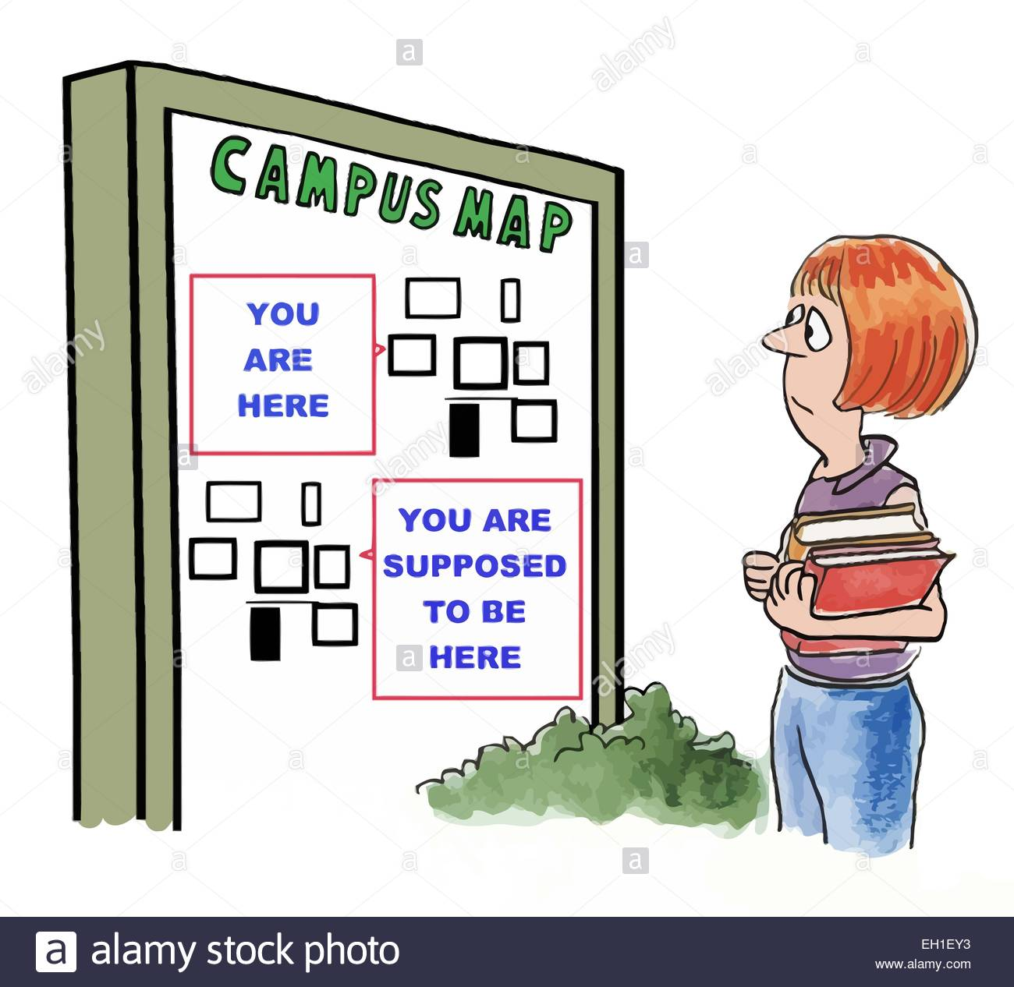
Summary+Motivation
My Bachelors Thesis is an application that is designed to lacate different classes in UAIC campus and guide the student to the desired location within the faculties.
Motivation:
Lack of space awareness that fresh students usually have.
In case of emergency, the firefighters or other parties can use the application to quickly understand the location of the problem.

Slide 4
Application flow

Slide 5
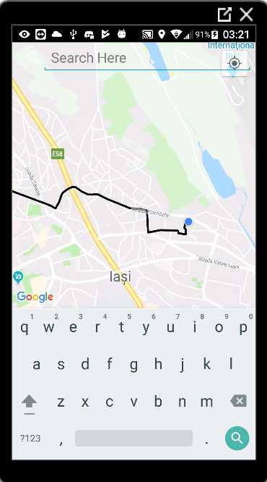
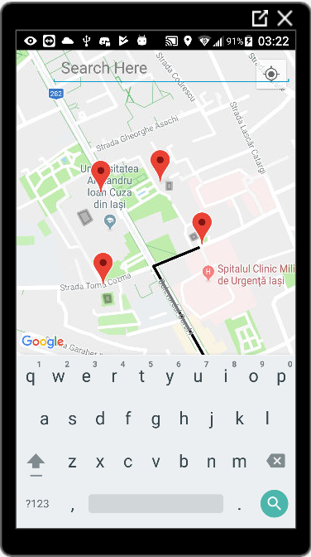

Slide 6
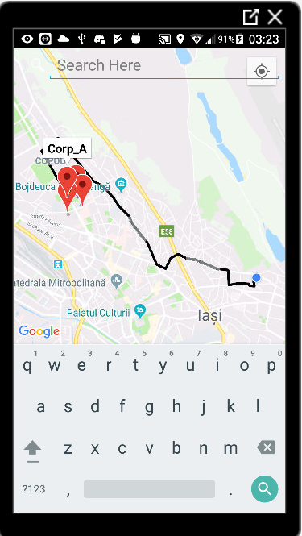
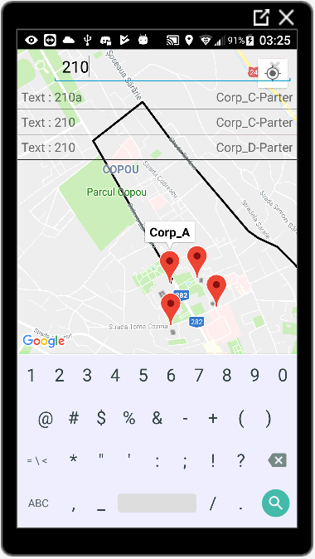

Slide 7
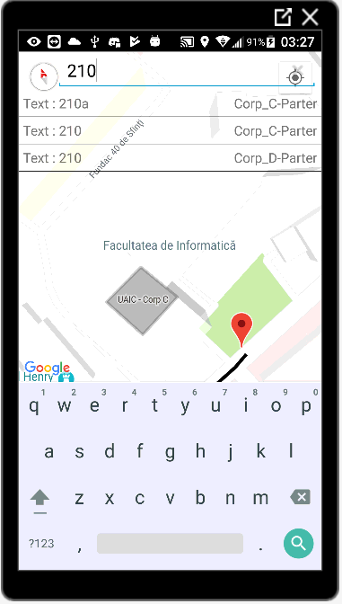
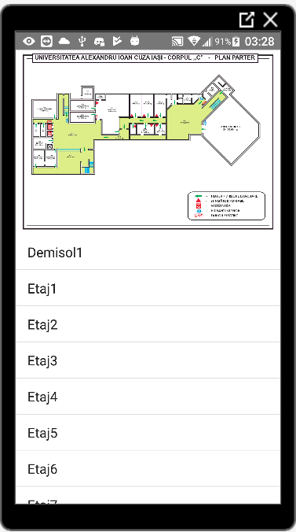

Slide 8
Image processing
-walls-

Slide 9
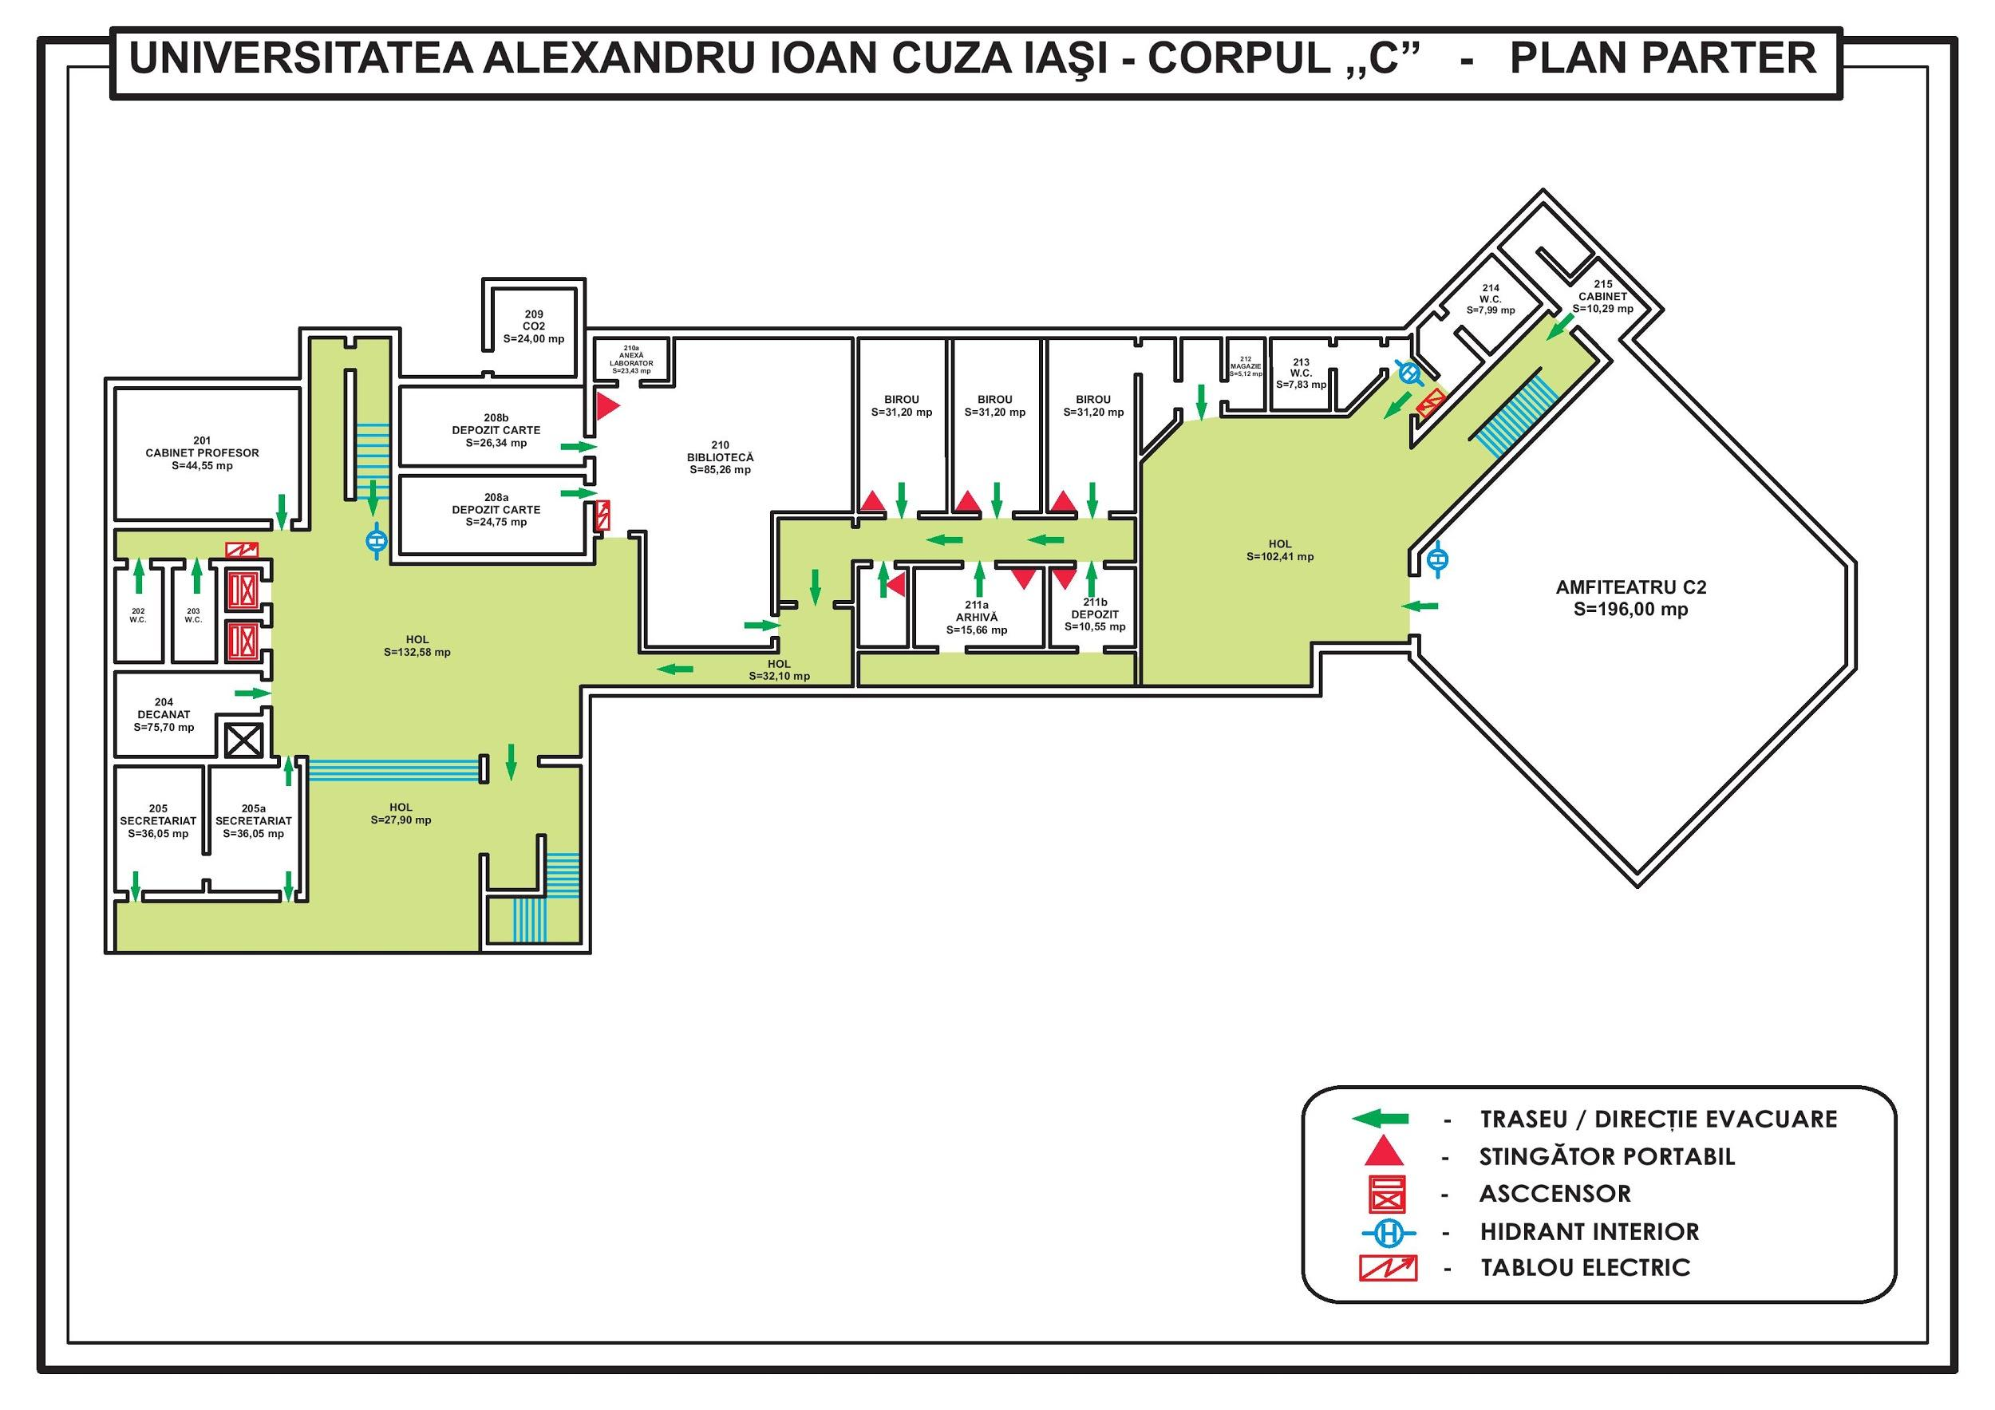

Slide 10
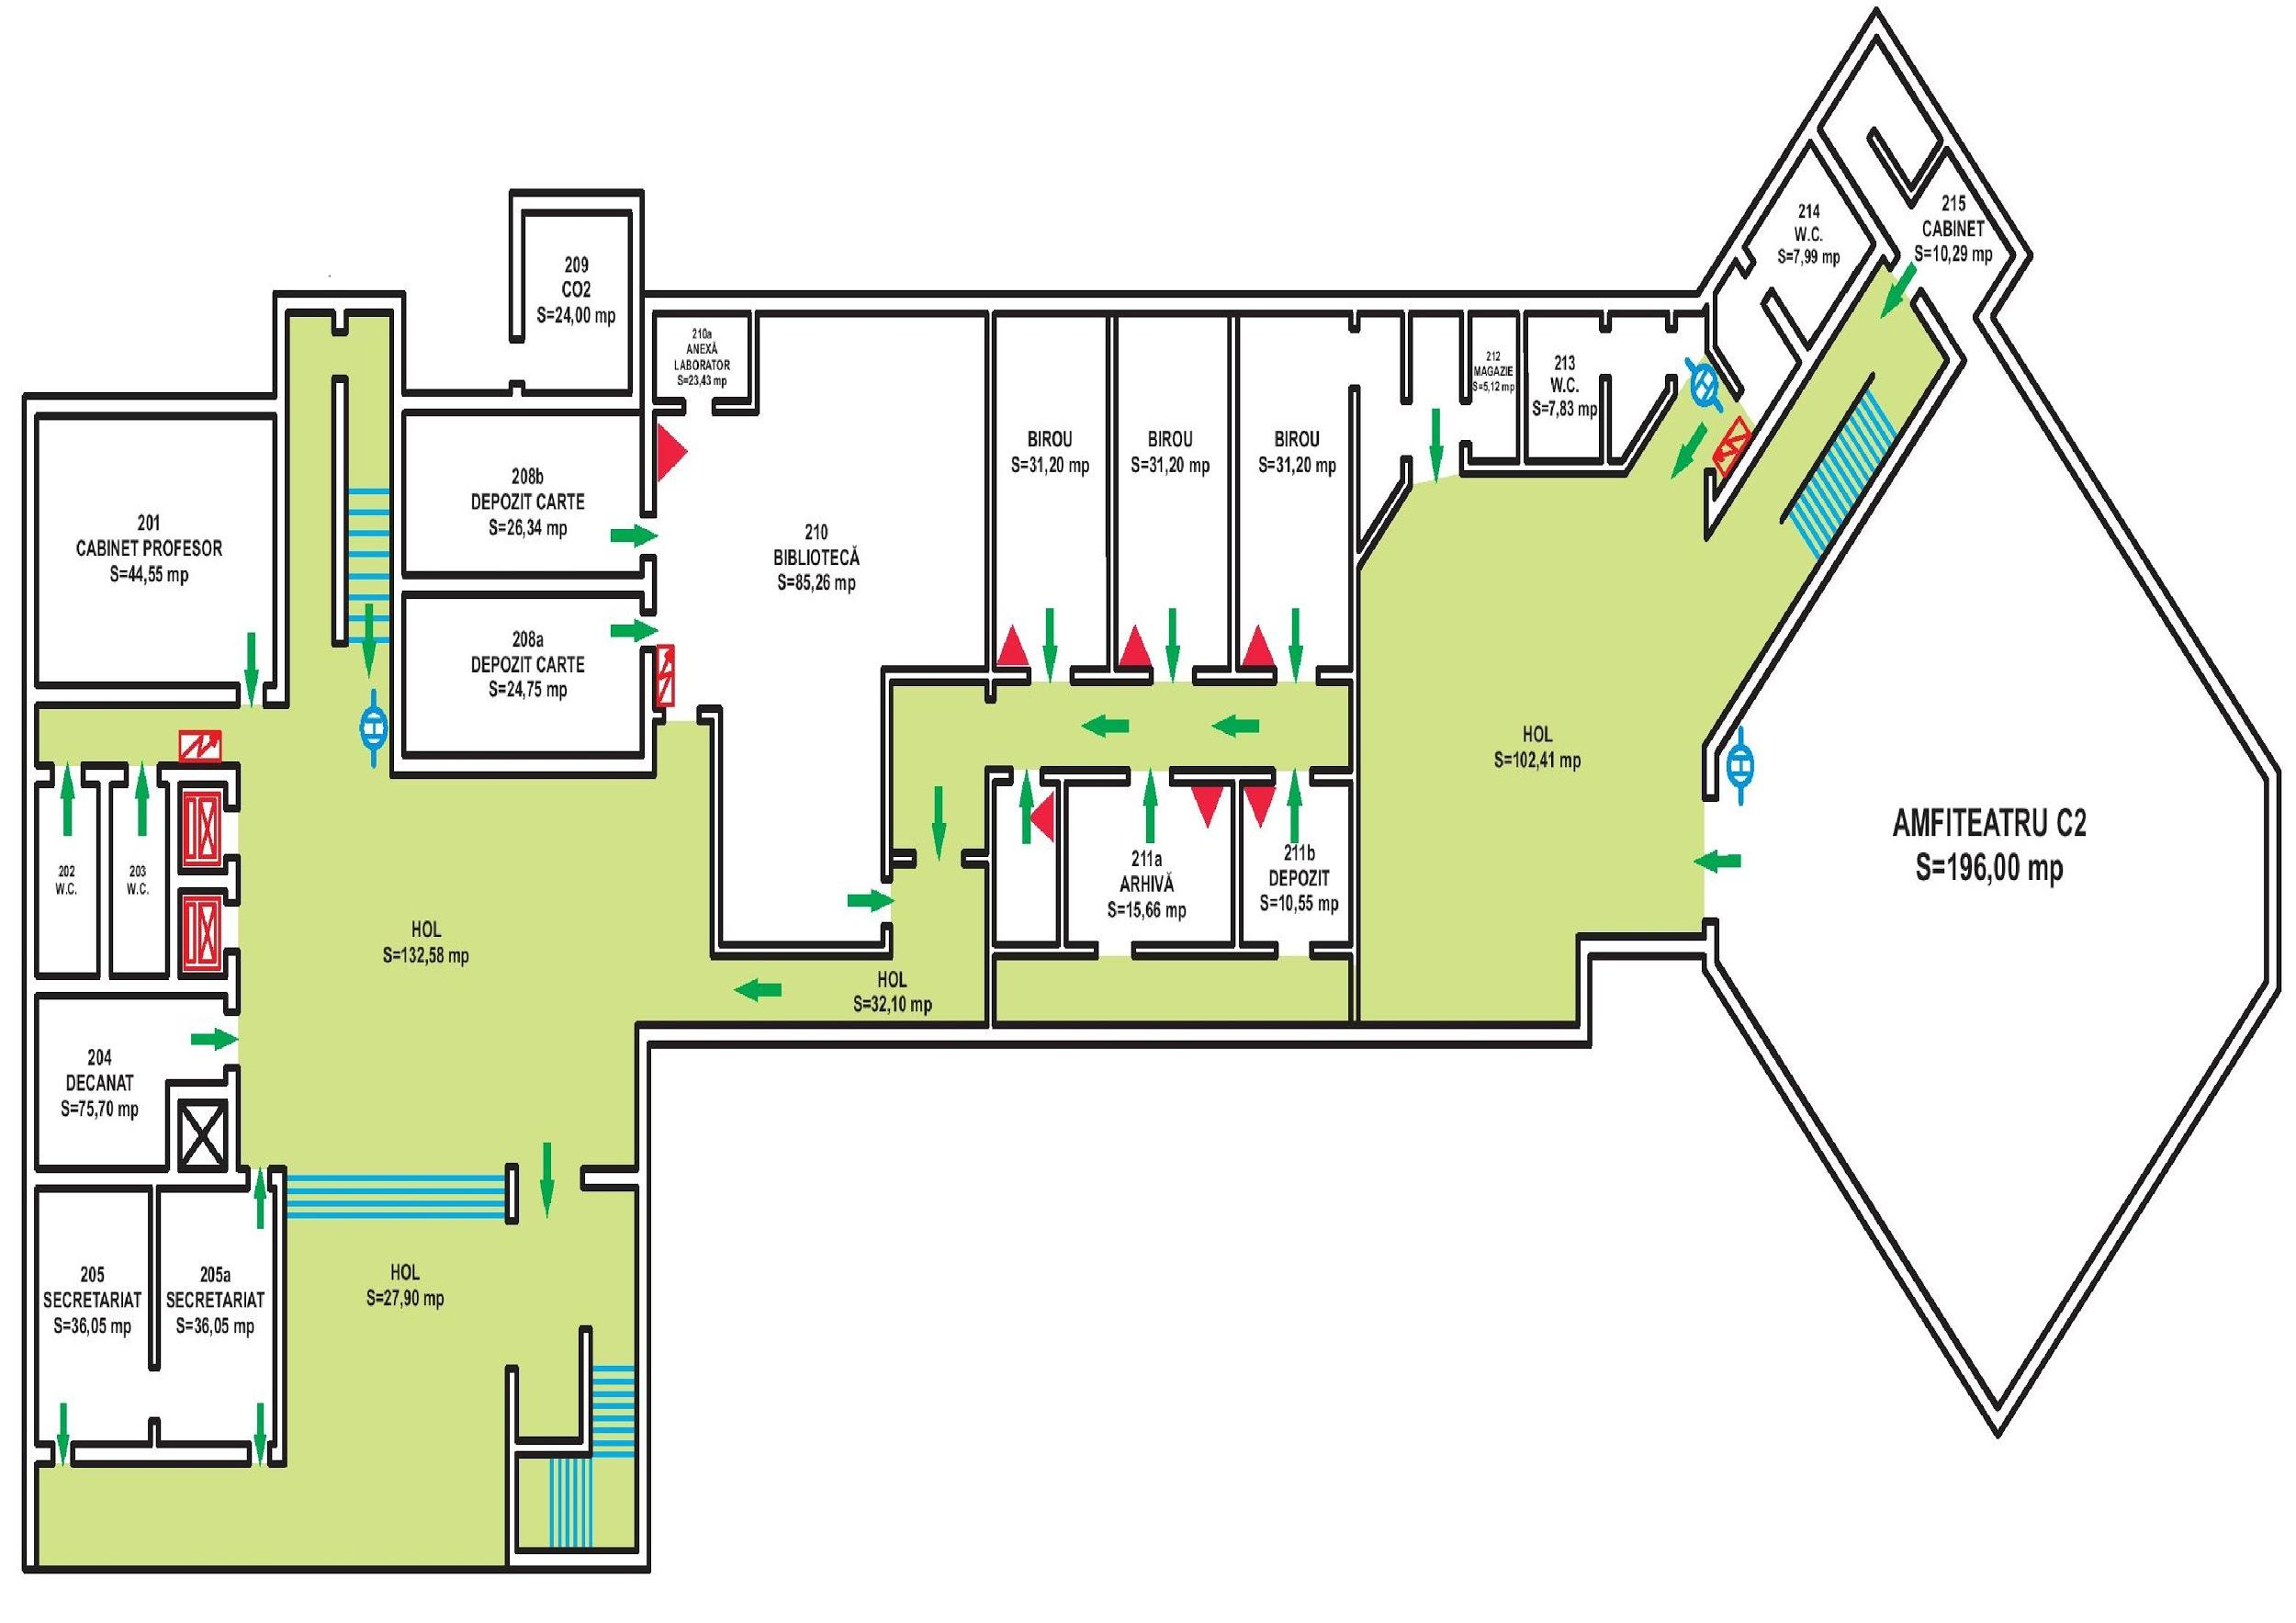

Slide 11
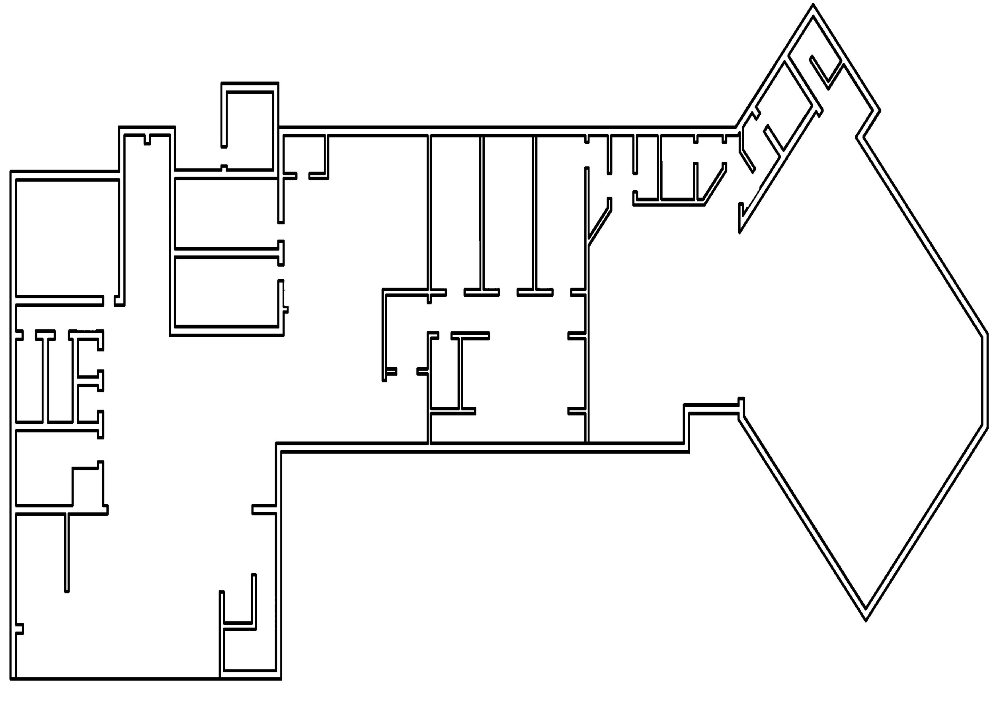

Slide 12
Image processing
-pathfinding-

Slide 13
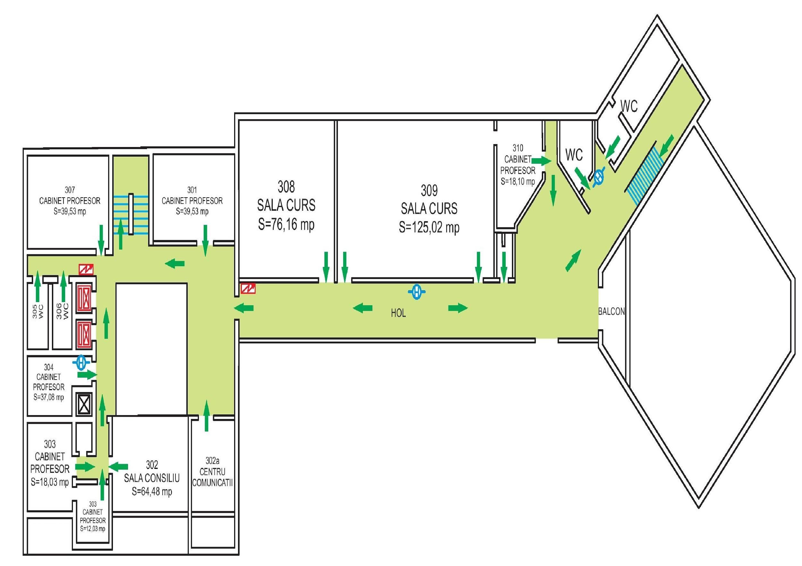

Slide 14
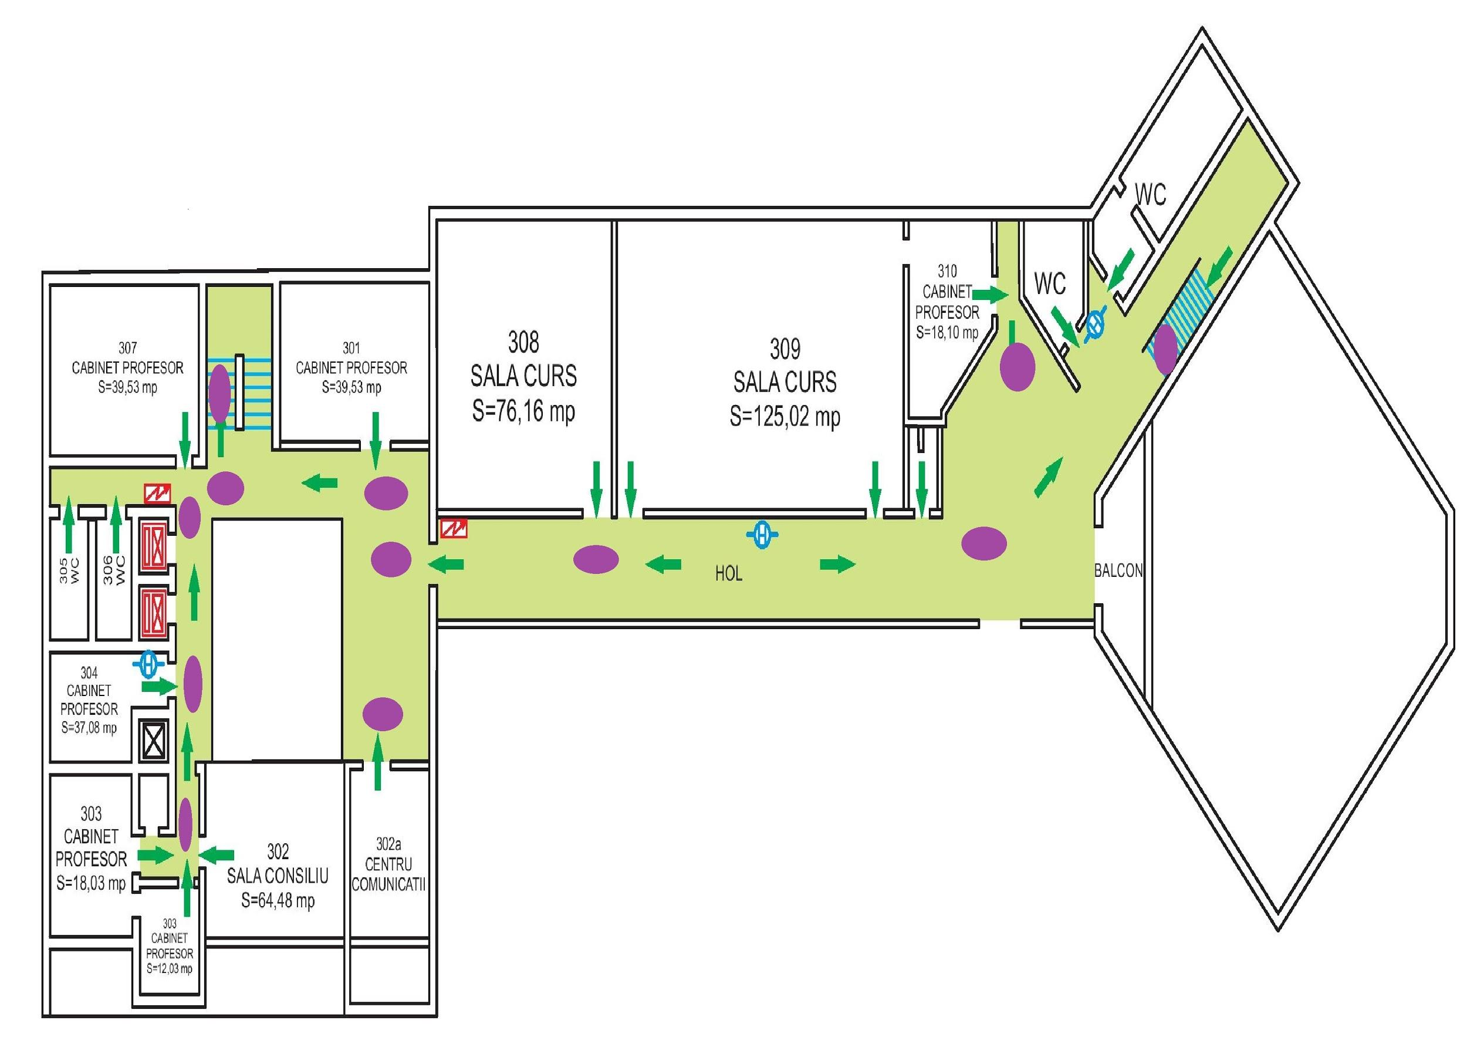

Slide 15


Slide 16
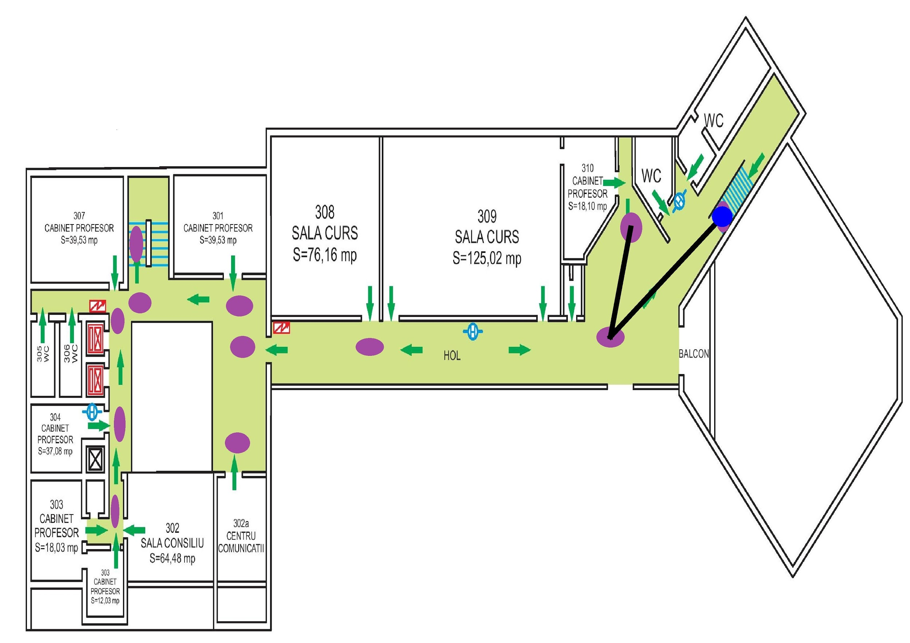

Slide 17
Used Technologies
Android development
Google Maps
Google Location
Java
Serialization cross platform
Google OCR
Algorithms
Lee algorithm
Breadth First Search ( BFS )
Euristic Image Recognition
Related solutions to the solved problems. ( motivation for the method used and why not other different approaches)

Slide 18
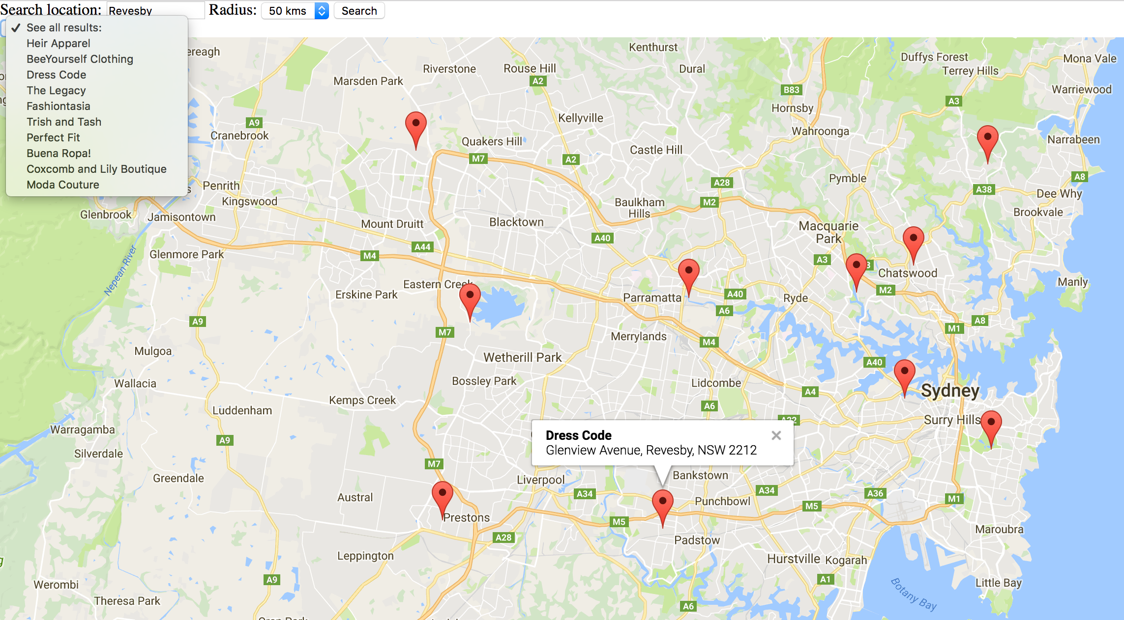
Google maps

Slide 19
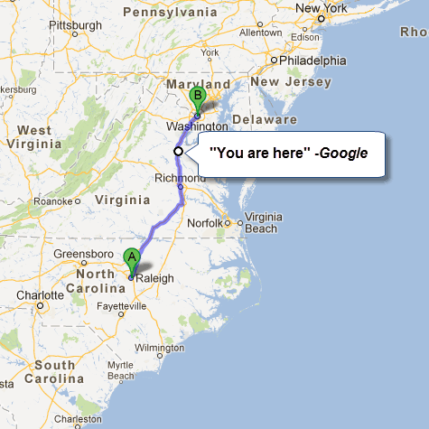
Google Location

Slide 20
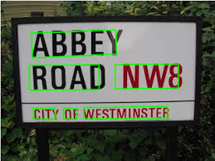
Google OCR

Slide 21
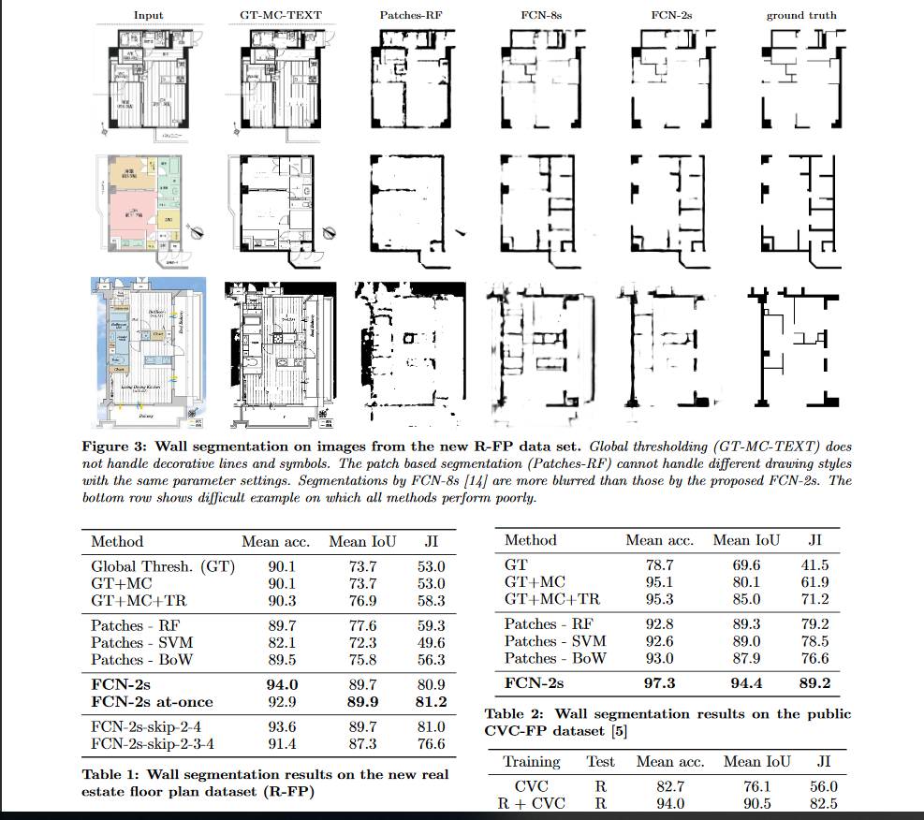
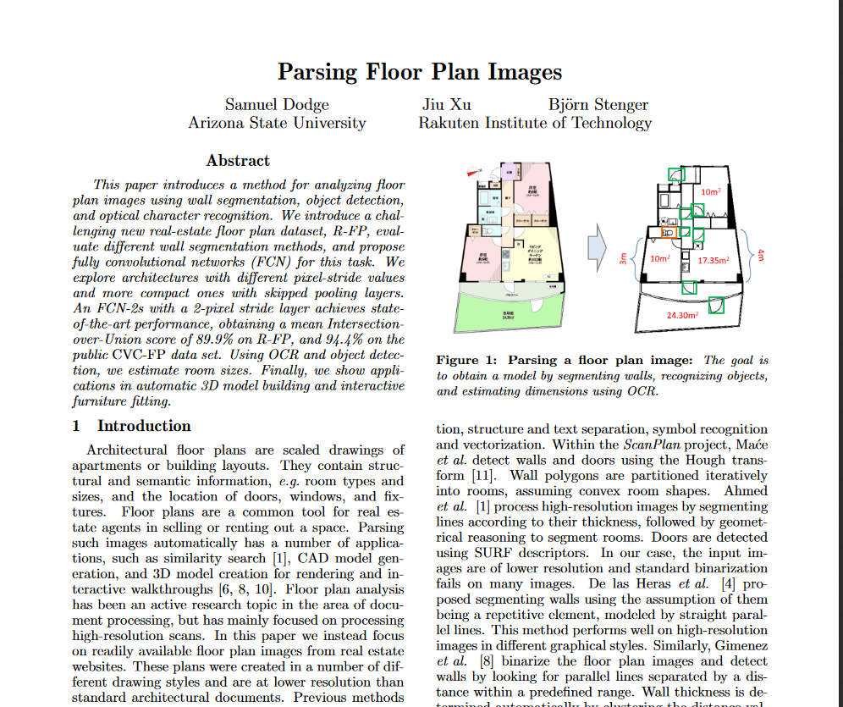
Image Recognition

Slide 22
Image Recognition
walls -
Use the colors of picture of to my advantage.
Time efficient
Simple to understand
High success rate
Possible problems from inconsistent datas

Slide 23
Image Recognition
pathfinding -
Create a pattern and use it to my advantage. From find in matrix to find in graph.
Time&Memory eficient.
Editable paths.
Needs admin work.

Slide 24
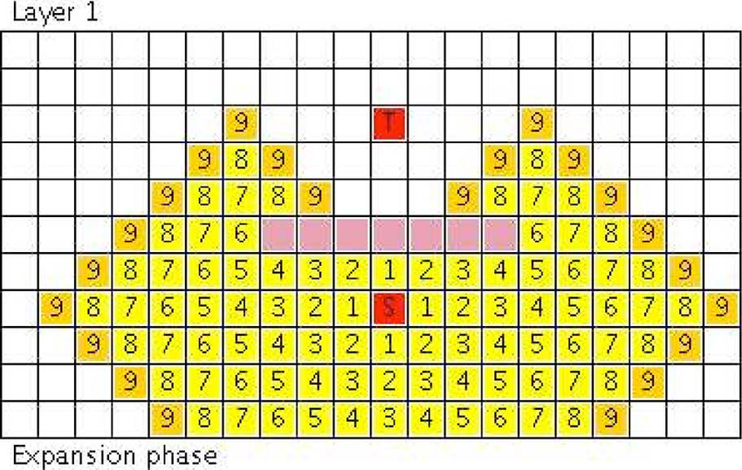
Lee algorithm
-pathfinding-

Slide 25
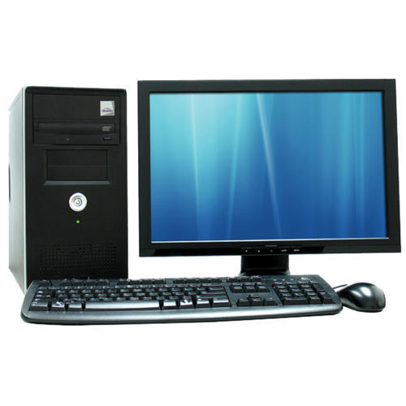
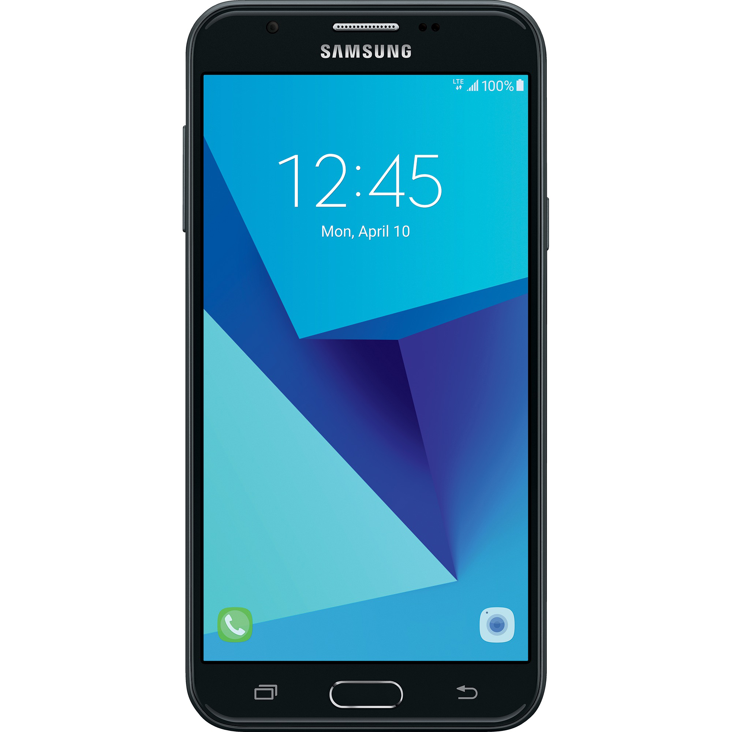
Work distribution
+

Slide 26
Use cases
Student
Fire Fighter
General Admin-> set-up and work

Slide 27
Contributions

Slide 28
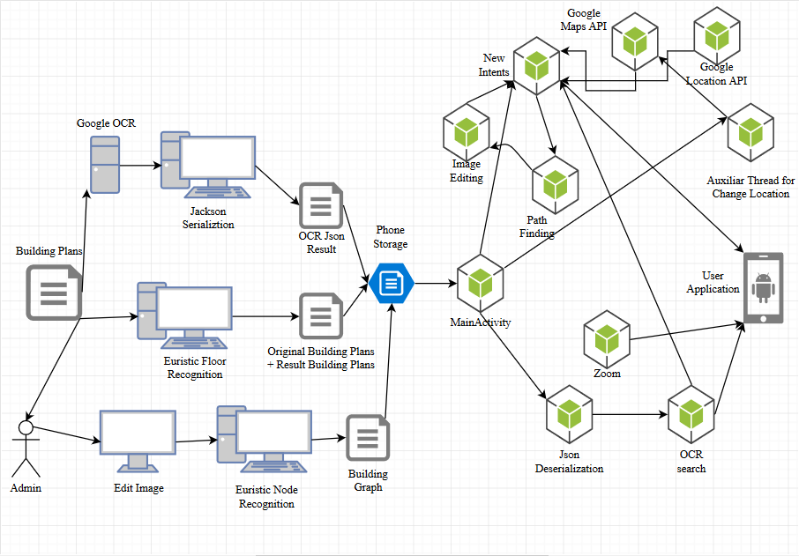
The architecture of the application.

Slide 29
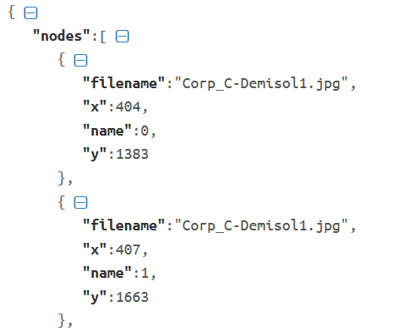
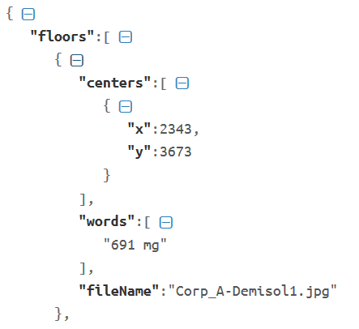
My own serialization/deserialization
Graph nodes
OCR results

Slide 30
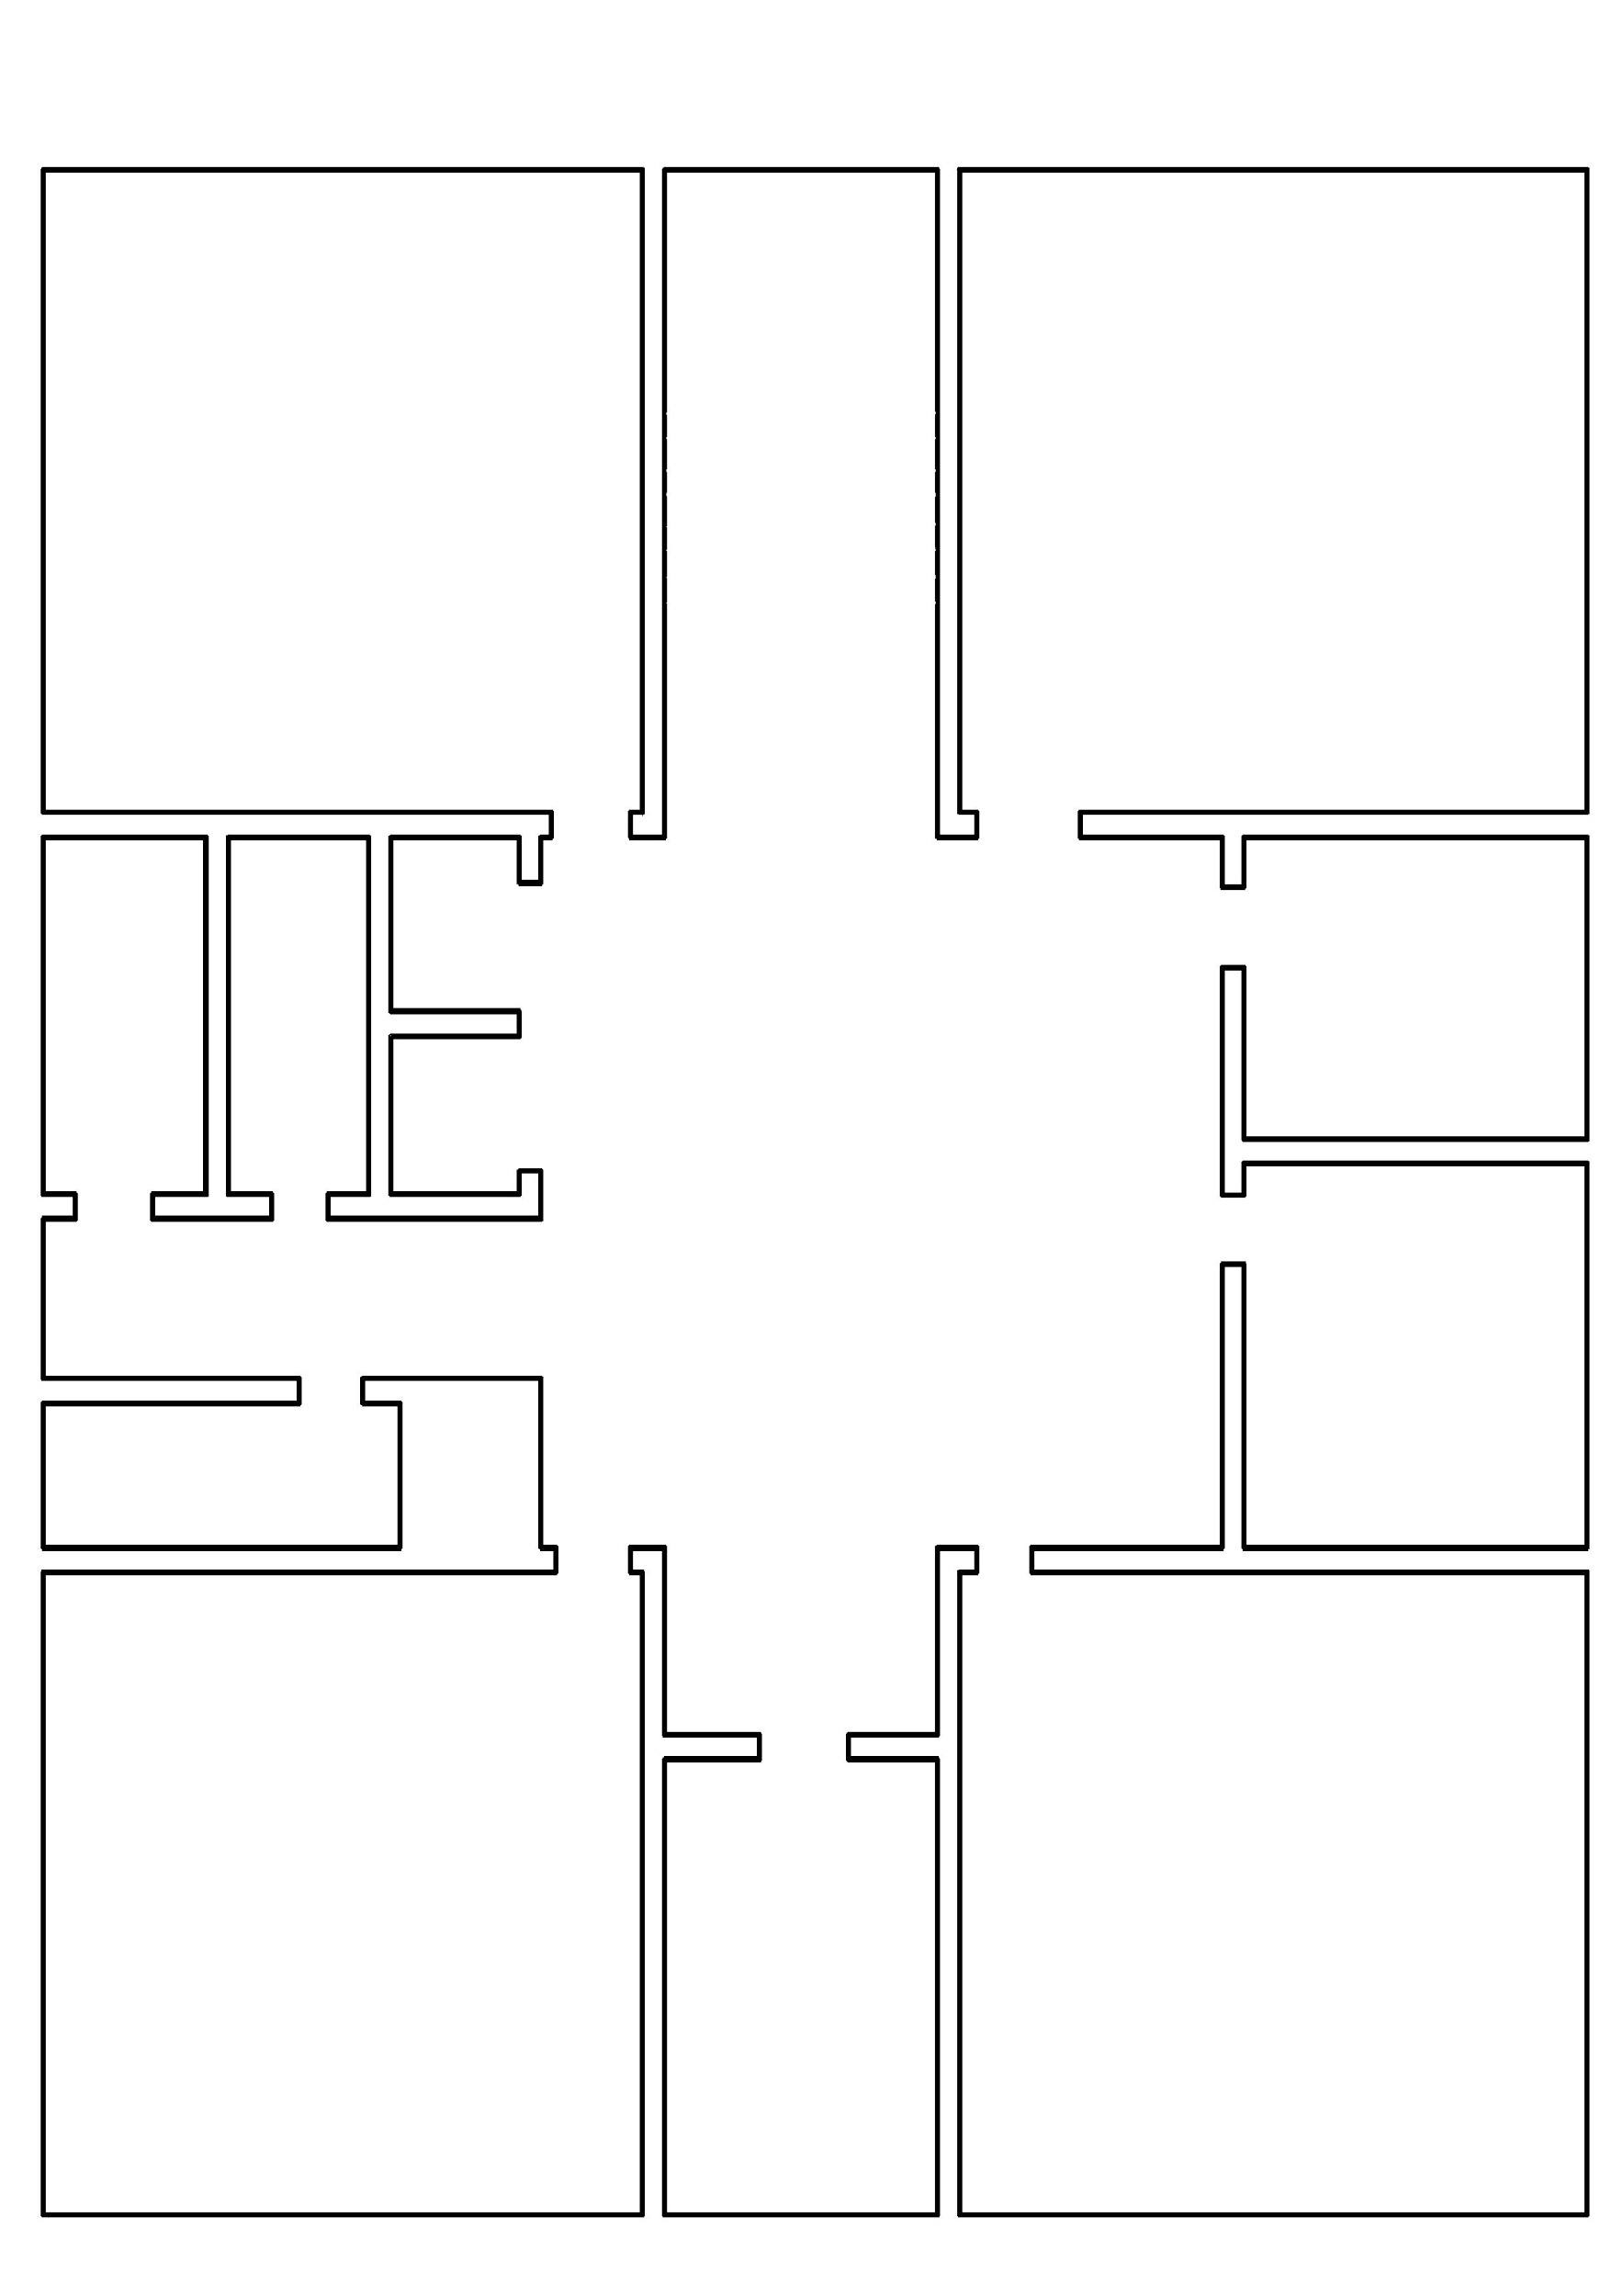
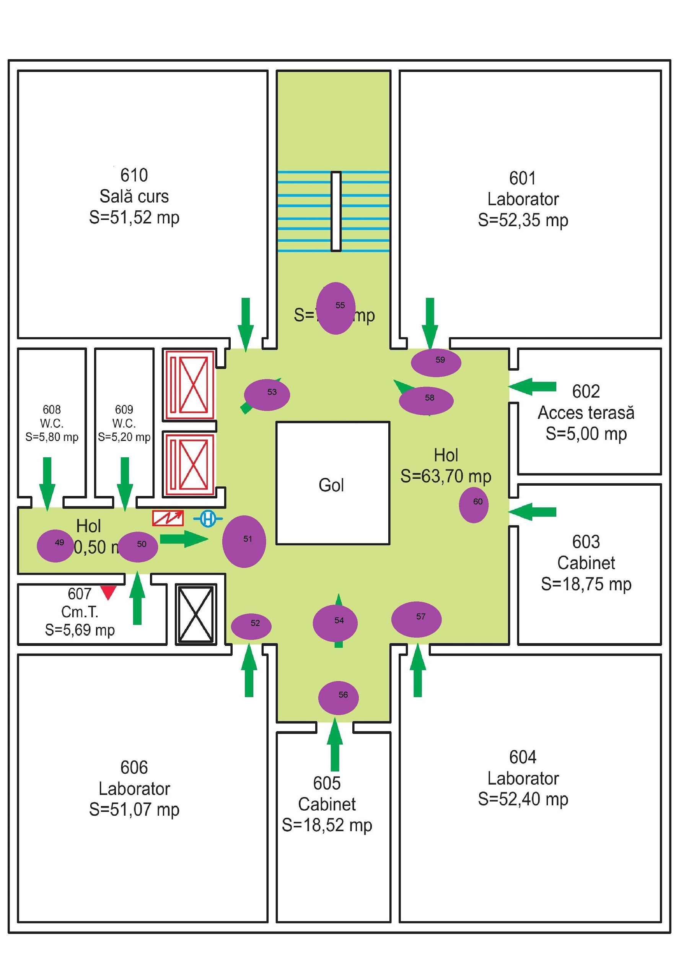
My euristic Floor Image Processing
Wall detection
Node detection

Slide 31
Research on application futures
Offline Tracking
When you enter a building and you lose GPS signal, but still want to know where you are.
Solutions:
Phone sensors
wifi triangulation
Problems:
GPS accuracy
3D Building
Given a building plan, construct a 3D model of the structure.
Solution:
Given my Wall Image Recognition, there are online builders that can construct a 3D model.
Problems:
GPS accuracy
Time&Memory on phone.

Slide 32
Application extensibility
The application is builded in such a way that not only it work for the UAIC building plans, but also for most of the building plans out there.
With my additional researches I mention possible further development for the application.
The administrator of the building has the freedom to construct paths in his own building.

Slide 33

Interesting & Challenging

Slide 34
Bibliography
Image Recognition print screens: http://bjornstenger.github.io/papers/dodge_mva2017.pdf
Google API + other images:
https://images.google.com

